Slide 1
Visual Decoding from EEG
By:
Group-43
– Atharv Kumar (B21038)
– Alok Kumar (B21149)
– Mourya Kondawar (B21016) – Hruthin Katta (B22047)
– Narendra (B22163)
– Devudu (B22117)

Slide 2
Introduction
This project explores the use of brain activity, specifically EEG (Electroencephalogram) signals, to understand and recreate visual stimuli, and textual stimuli. By leveraging advanced machine learning models, we aim to bridge the gap between brain signals and visual content generation.
Understanding how the brain encodes and processes visual information can open new avenues in fields like neuroscience, brain-computer interfaces, and human-computer interaction.
Current techniques focus primarily on text-based descriptions for image generation, but bypassing this intermediate step and generating images directly from EEG signals can lead to more intuitive applications, such as "thought-to-image" reconstruction.

Slide 3
Objectives
Develop a Textual Encoding Pipeline Using EEG Signals: Create a robust framework that can extract meaningful features from EEG signals and use them to represent and understand visual stimuli through textual information.
Integrate Multi-Modal Techniques for Image Reconstruction: Leverage image captioning (using BLIP) and image generation (using Stable Diffusion) to reconstruct high-quality images based on brain activity data.
Enable Direct "Thought-to-Image" Conversion: Upgrade the textual encoding to achieve seamless image generation from EEG signals without relying on textual intermediates, demonstrating the potential of brain activity-driven visual content creation.

Slide 4
Background and Existing Methods
Traditional methods rely on fMRI-image paired data to train the model to predict image features from fMRI. These images are fed into GANs for stimulus reconstruction during testing. However recent studies have proposed unsupervised approaches, such as a reconfigurable autoencoder designs. The drawback of using the fMRI signals is that fMRI equipment is not portable and needs to be operated by professionals. Secondly cost of fMRI acquisition is high and also they have high spatial resolution but low temporal resolution.
Generating images from EEG has also been explored using deep learning techniques like Brain2Image, ThoughtViz etc. Overall these approaches demonstrate the potential of using brain signals to generate images and advance the field of brain-computer interfaces.

Slide 5
Overall Model
Reconstructed Image
EEG embeddings
EEG signal
VAE Model
Training MaskedCLIP to convert EEG embeddings to Text Embeddings
Text Embeddings
Generated Text
Stable Diffusion Model
EEG Dataset (EEG signal, Image, label)
GPT-2 Text Decoder
BLIP -2
Images
Generated Captions
Depth Information
GCNN
Depth Map from EEG

Slide 6
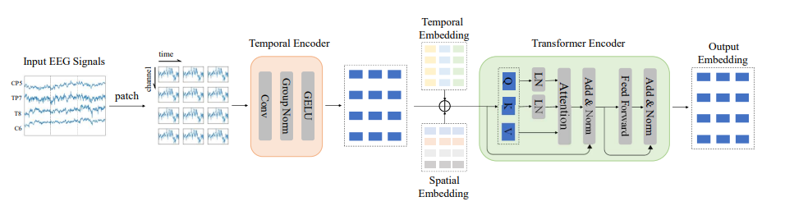
Methodology
LabRaM Model: deep learning model that creates robust, meaningful EEG embeddings by combining autoencoder principles with label information, leading to better signal representation and analysis.

Slide 7
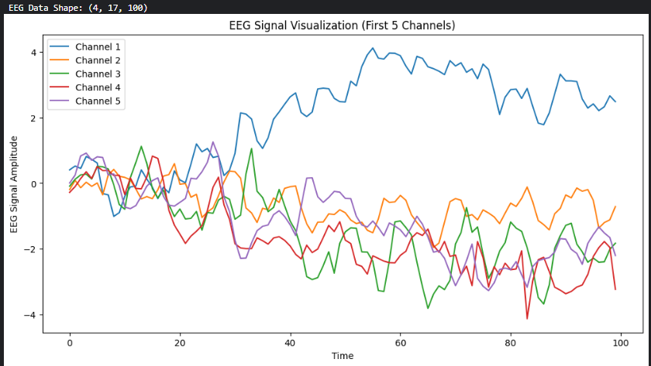
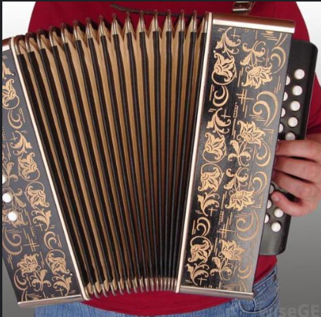
Dataset
The dataset contains of three parts :
EEG data Signals
(16740 samples, 17 channels, 100 timepoints)
Images
Labels
(Note the same Images(16740) were shown to 10 separate subjects and the EEG signal was recorded. This is we have a data of 16740 eeg samples for each of the 10 subjects.)
EEG Signal
Corresponding Image

Slide 8
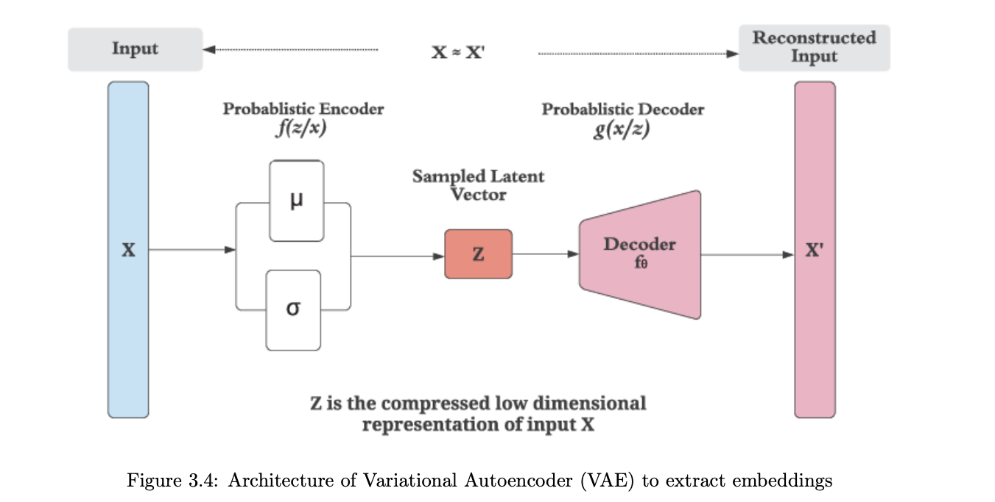
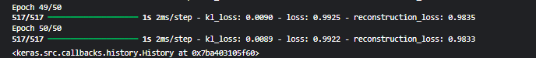
Methodology
VAE (Variational Autoencoder) The encoder learns to represent EEG data as latent vectors (embeddings), while the decoder reconstructs the original signals. Training minimizes reconstruction loss and KL divergence, ensuring embeddings capture meaningful features. These embeddings will further be used along with text embeddings in Cross-Modal alignment. (trained on DEAP dataset then used)

Slide 9
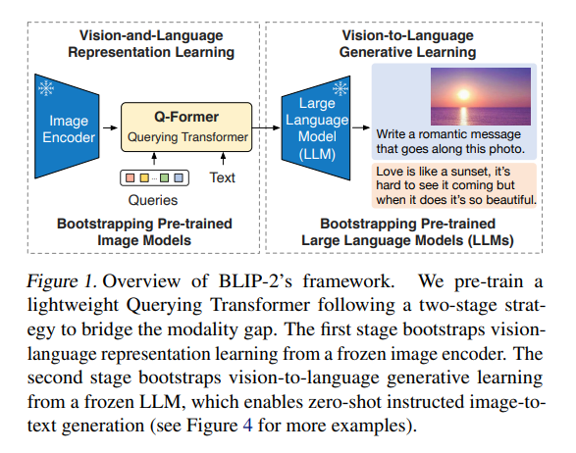
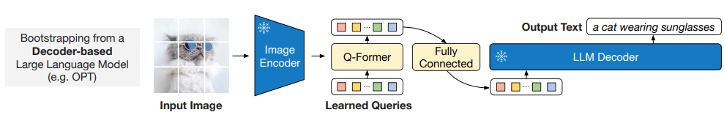
Methodology
The task is to generate best fit captions for our stable diffusion model.
Fine-Tuning BLIP-2: Bootstrapping Language - Image Pre training model on our dataset and trying to generate captions which we could give to the stable diffusion model for image reconstruction.

Slide 10
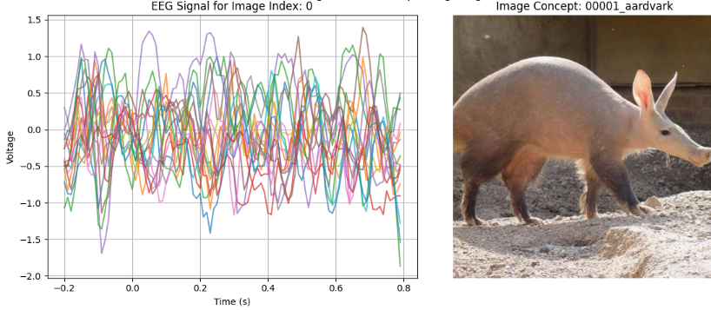
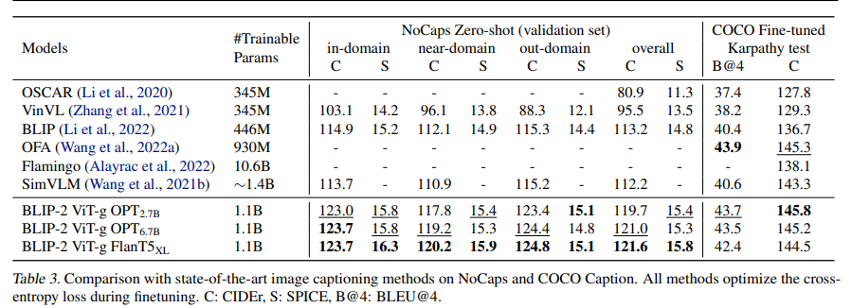
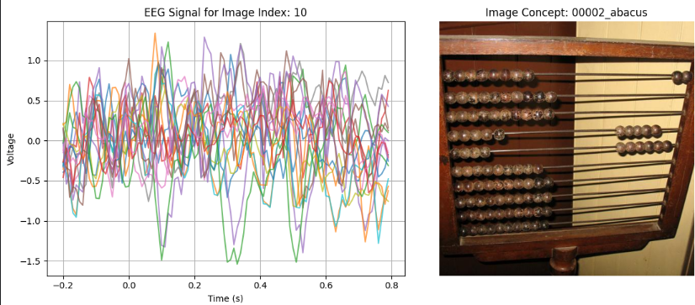
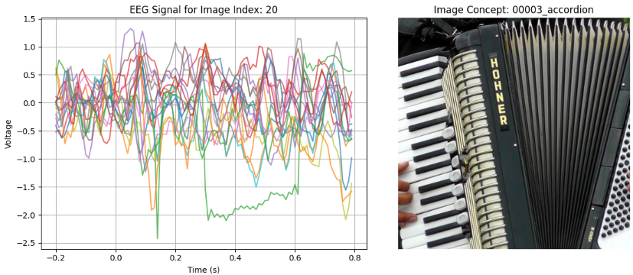
Results from BLIP-2
Generated Caption: a small armadillo walking on the dirt
Generated Caption: an abacus with many beads on it
Generated Caption: a person playing an accordion in the park

Slide 11
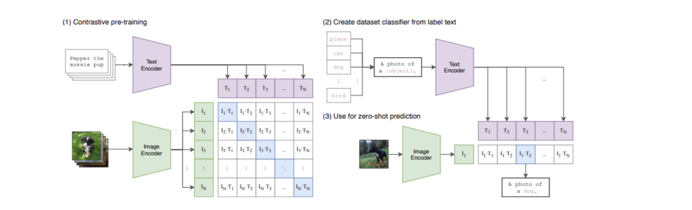
Methodology
Cross Modal Alignment: EEG embeddings and the text are bought into a common latent space, and both embeddings are brought closer using the CLIP model. This alignment ensures that embeddings derived from EEG Signals correspond to meaningful textual features, facilitating effective multimodal integration. The CLIP model is trained on the same to convert EEG to Text Embeddings. (Masked CLIP is being planned to be used to increase the performance (pertaining to various subjects))

Slide 12
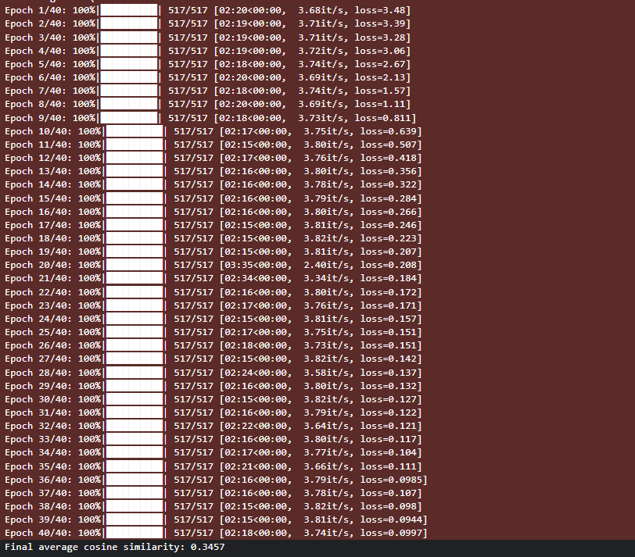
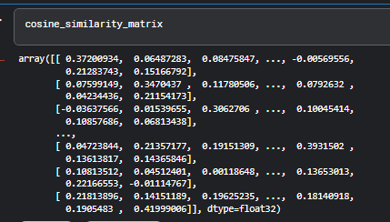
Results from Cross Alignment
Fig : The final cosine similarity matrix depicting higher weight along the diagonals (matching pairs are given more weight than non matching pairs) [Note: We are planning to use Masking in CLIP to improve the overall performance]
Fig : The training process of CLIP showing the contrastive loss reduce from 3.48 to 0.121 in 30 epochs showing that the text and the eeg embeddings are brought closer

Slide 13
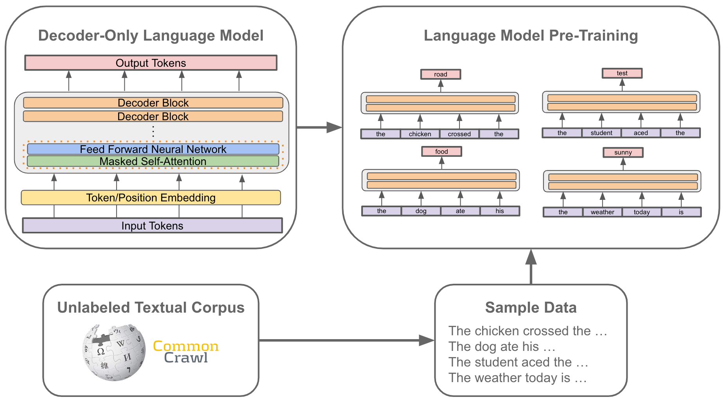
Methodology
GPT-2 Text Decoder: These projected embeddings are fed into the GPT-2 language model, which then autoregressively generates coherent and contextually relevant text. During training, the model minimizes cross-entropy loss on the next-token prediction, while inference uses sampling strategies like top-k or nucleus sampling to produce diverse and meaningful text outputs.

Slide 14
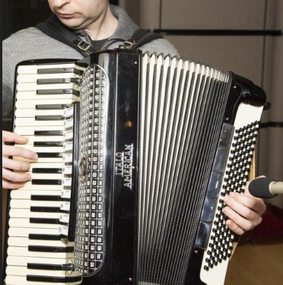
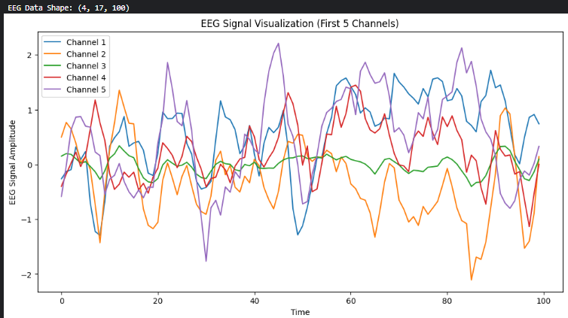
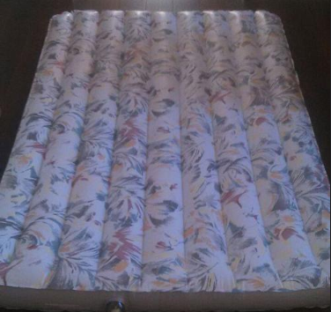
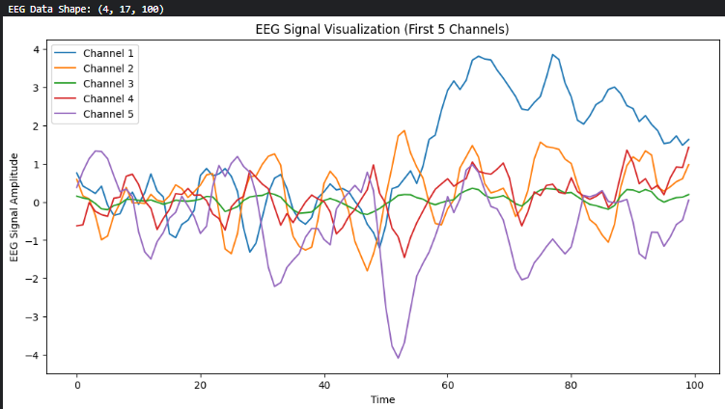
Results (EEG to Text)
Generated Text from (EEG): a man holding an accordion in front of a microphone
ROUGE Score {'rouge1': Score(precision=0.4, recall=0.5, fmeasure=0.4444444444444445)}
BLIP-2 Caption: a person playing an accordion in the park
Image
Corresponding EEG Signal
Generated Text from (EEG): a floral air mattress sitting on top of a bed
ROUGE Score { 'rouge1': Score(precision=0.5, recall=0.5555555555555556, fmeasure=0.5263157894736842)}
BLIP-2 Caption: an air mattress with a floral pattern on it
Image
Corresponding EEG Signal

Slide 15
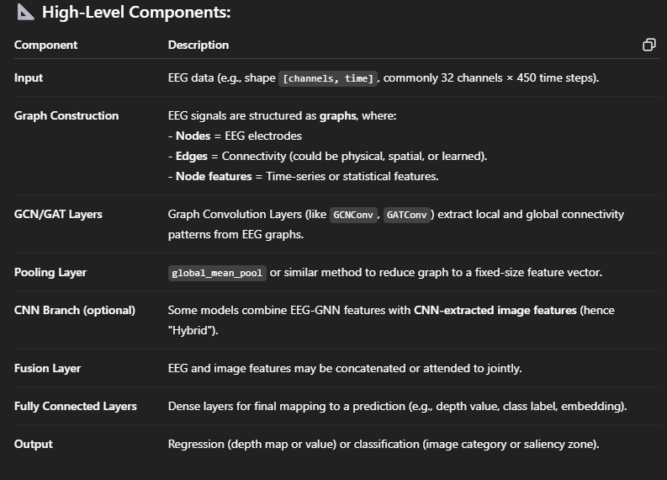
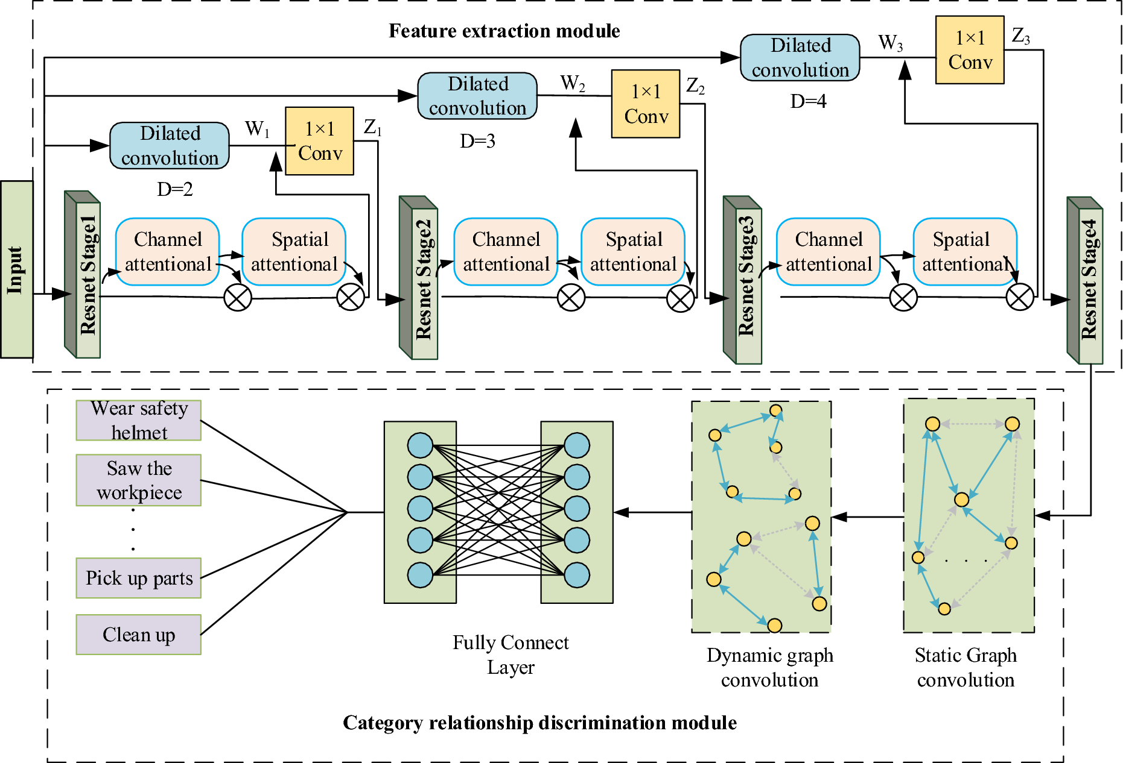
Methodology
GCNN: The underlying hypothesis is that the spatial and functional relationships between EEG channels can be effectively modeled using graph structures, and that learning such representations can bridge neural activity and visual depth perception or image understanding.

Slide 16
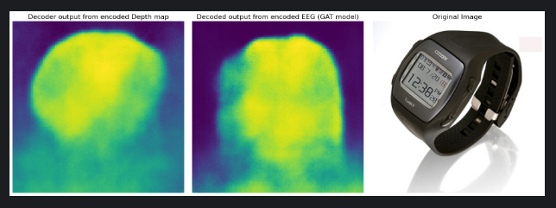
Results (EEG to Depth)
# Generating Depth Map directly from EEG ( GAT ) model. [second pipeline]

Slide 17
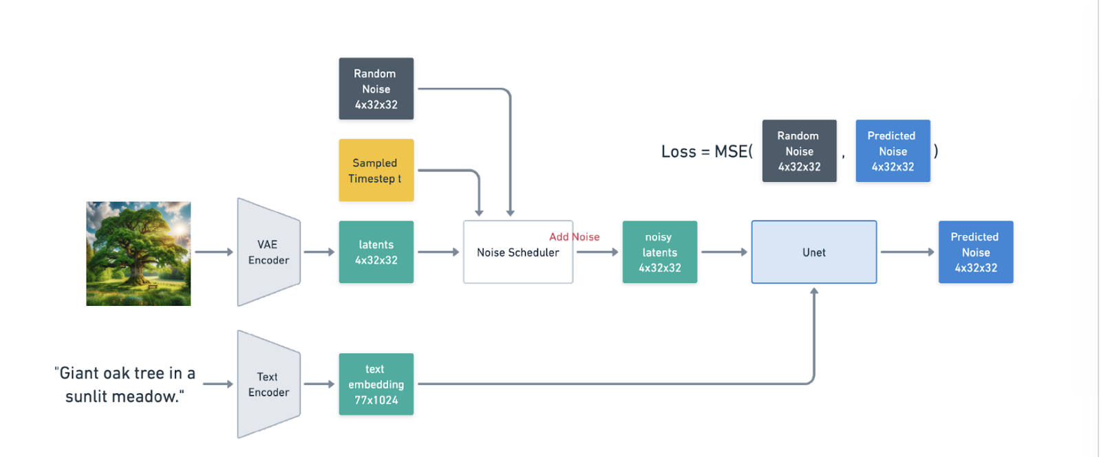
Methodology
Stable Diffusion : Stable Diffusion is an advanced generative model that transforms textual prompts into high-quality images. It leverages a diffusion process, which involves progressively adding noise to an image until it becomes indistinguishable from random noise. The model then reverses this process, learning to reconstruct the image, thus enabling detailed visual generation from text prompts. The architecture includes a U-Net for image synthesis and a text encoder that translates prompts into a latent space representation.

Slide 18
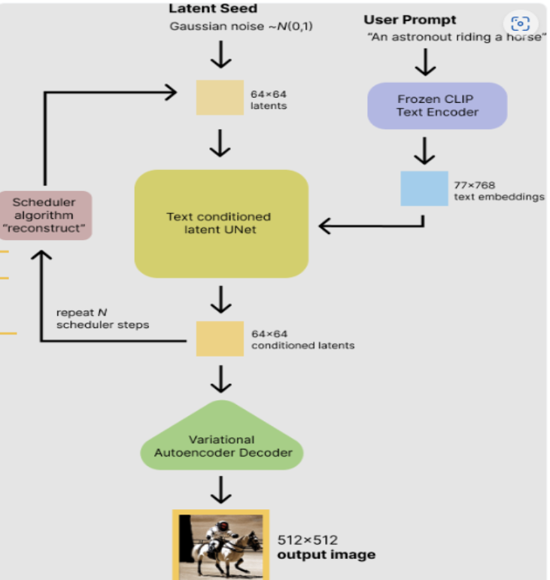
Our model brings EEG embeddings (from VAE) and text embeddings (from BLIP-2) into a shared latent space, aligning them using the CLIP model. The CLIP model is trained to predict text just from EEG embeddings. This alignment ensures that EEG-derived embeddings correspond to meaningful textual features, enabling effective multimodal integration. The text is then used as prompts along with depth information in a diffusion model to guide brain-informed image generation.

Slide 19
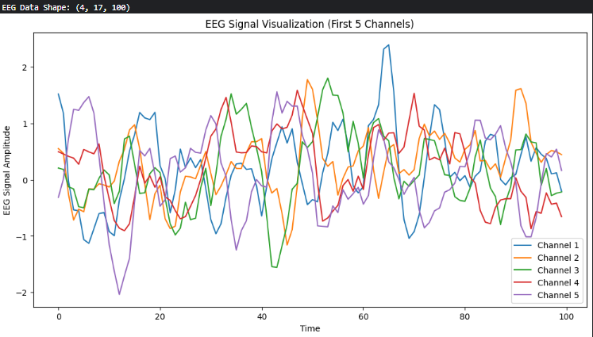
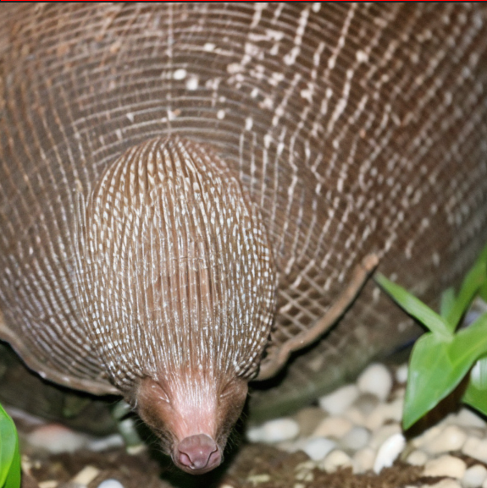
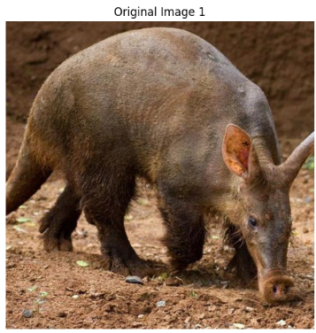
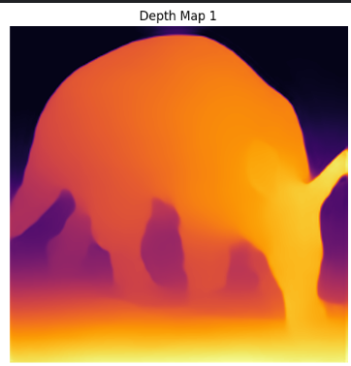
Results (Visual Decoding using Stable Diffusion)
Generated Text:
a baby armadillo in its enclosure at the zoo
EEG Signal
Stable Diffusion Model (stabilityai/stable-diffusion-2-1-base)
Reconstructed Image
SSIM : 11.02%
Original Image
BLIP Generated Caption: a small armadillo walking on the dirt

Slide 20
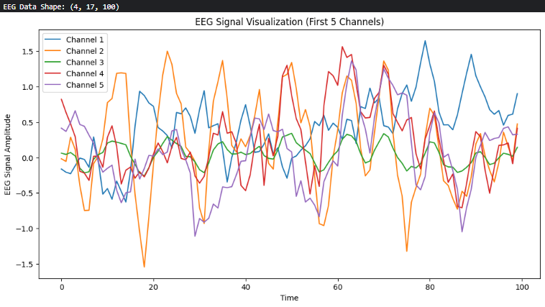
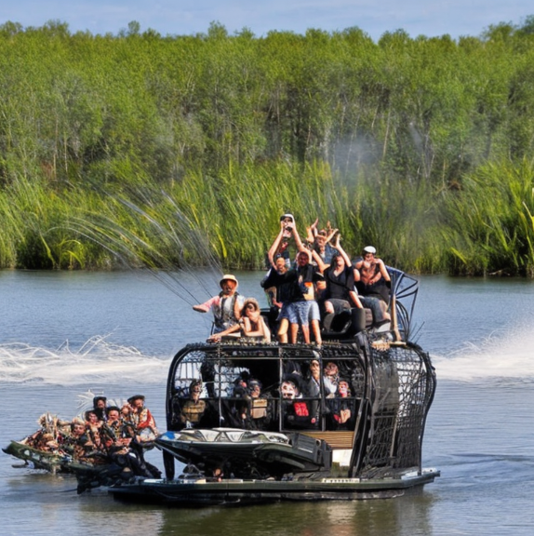
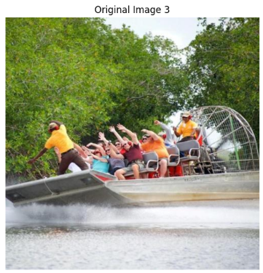
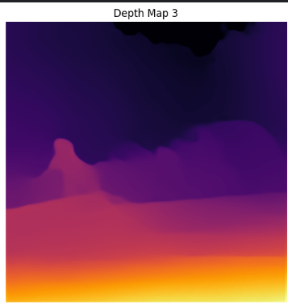
Results (Visual Decoding using Stable Diffusion)
Generated Text:
a group of people riding in an airboat
EEG Signal
Stable Diffusion Model (stabilityai/stable-diffusion-2-1-base)
Reconstructed Image
SSIM : 14.32%
Original Image
BLIP Generated Caption: a group of people riding in a boat on the water

Slide 21
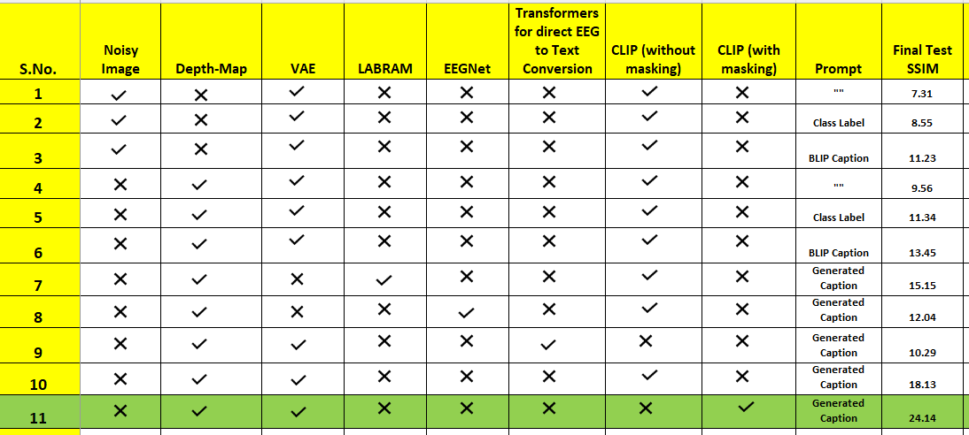
Results (Quantitative Results and Ablation Study)

Slide 22
Discussion and Conclusions
In this project, we tackled the challenge of visual encoding using EEG signals, focusing on three key pipelines.
First, we extracted depth information from EEG data, addressing the complexities of interpreting brainwave signals to estimate spatial and temporal information.
Next, we generated captions for the corresponding images using BLIP-2, ensuring the captions accurately described the image content.
Next we used the concept of training a Masked CLIP model to convert EEG to Text.
Finally, a noisy image, the generated text, and the extracted depth information were combined in a stable diffusion model to reconstruct the image.
We have done experimentation to see how we can get the best results from our model
Each step presented unique challenges, from noise in EEG data to the quality of image reconstruction, leading to insights on the strengths and limitations of the integrated approach.

Slide 23
Future Work and Timeline
January
Worked on compiling the experimentation results which we have got from MTP-1
Move towards the testing procedure using models like BLIP-2 , Masked CLIP, VAE to improve the quality of eeg embeddings and generated captions.
February
Weeks 1-2:
Training the CLIP model to convert EEG to Text.
Exploring various encoders to get the best embeddings (like hvEEGNet) and decoders to convert the generated text embeddings back to text.
Researched for other models to directly convert EEG to Text without using CLIP. (DeCap)
Weeks 3-4:
Compiling all the work , generated the required results.
(Future Work)
March: Improve Overall Accuracy of the model
Compare performance of the original and modified models using benchmark datasets and doing some Experimentation to produce the best results from our model.
April and May: Generalizing the Model to multiple subjects, Benchmarking and Submission
Analyze results and prepare the final report for submission by the end of November.

Slide 24
References
Radford, A., Kim, J. W., Xu, C., Desai, G., & Sutskever, I. (2021). Learning transferable visual models from natural language supervision. In International conference on machine learning (pp. 8748-8763). PMLR.
Li, J., Li, D., Xiong, C., & Hoi, S. C. (2022). Blip: Bootstrapping language-image pre-training for unified vision-language understanding and generation. In International Conference on Machine Learning (pp. 12888-12900). PMLR.
Brown, T. B., Mann, B., Ryder, N., Subbiah, M., Kaplan, J., Dhariwal, P., ... & Amodei, D. (2020). Language models are few-shot learners. Advances in neural information processing systems, 33, 1877-1901.
Chung, H. W., Kim, Y., Hou, X., Longpre, S., Odena, A., Raffel, C., ... & Zhou, D. (2022). Scaling instruction-finetuned language models. arXiv preprint arXiv:2210.11416.
Zhu, L., & Yang, Y. (2020). Actbert: A hierarchical transformer for temporal structured activity recognition. In Proceedings of the 28th ACM International Conference on Multimedia (pp. 436-445).
Radford, A., Kim, J. W., Xu, C., Desai, G., & Sutskever, I. (2021). Learning transferable visual models from natural language supervision. In International conference on machine learning (pp. 8748-8763). PMLR
Rombach, R., Blattmann, A., Lorenz, D., Esser, P., & Ommer, B. (2022). High-resolution image synthesis with latent diffusion models. In Proceedings of the IEEE/CVF Conference on Computer Vision and Pattern Recognition (pp. 10684-10695)

Slide 25
Thank you

